Slide 1
K Nearest Neighbour

Slide 2
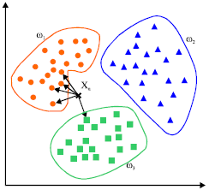
The Big Idea

Slide 3
The Big Idea: KNN for Classification
Lets take the example again of height and weight. Here our target (Y) is a binary variable {1:Not Athletic,2: Mildly athletic, 3:Very Athletic}. Assume right now we only have 2 features (X1 = Height and X2 = Weight).
The basic idea is that if we get a new data row (a new X1,X2 pair) then KNN assigns this pair a class based on which class the K near points have.
If K = 1, then only the 1 nearest point is chosen to compare to. K can take on values between 1 and N (the number of data observations)

Slide 4
Flow of KNN
Calculate euclidean distance between a test point and all other training points. E.g train = {2,3} and test = {6,1}. Distance = sqrt((2-6)² - (3-1)²) = 4.24
Data points sorted by distance (lowest first)
Take the sum for each of the K nearest neighbours
In a classification setting, we do majority voting, the most frequent class between the K closest points is the class assigned to our test data point. This works in both binary and multiclass contexts
In a regression setting, we use the average Y value of K nearest training points. So y_pred_i = 1/K ∑y_{training_i}.

Slide 5
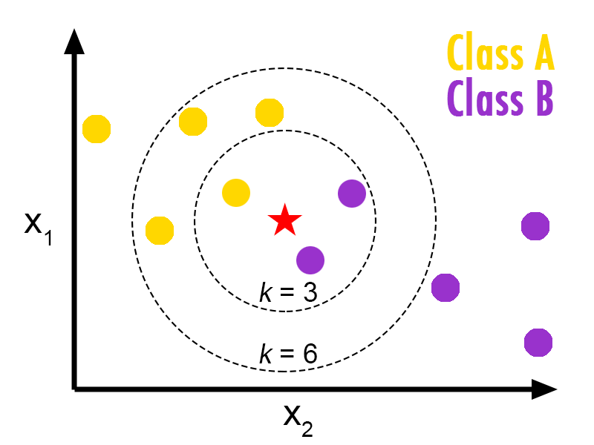
KNN: Classification

Slide 6
So, how should we choose our K?
Lets look at this in terms of Bias and Variance. What will happen if I choose a K = 1? What will happen if I choose 25?
A general rule is to set the initial K = 10 and see if increasing or decreasing this incrementally leads to a better prediction.

Slide 7
Lets look at the pros and cons
Pros:
Very quick and efficient algo (low training time)
Surprisingly effective and easy to intrepret
Cons:
Each feature has the same weight, relative importance of features not learned.
Needs to be scaled to work well

Slide 8
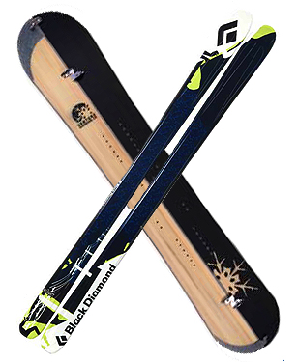
Snowboards and Ski’s

